Slide 1
Topic 1.4 Information and Communication Technology (ICT) Skills and Working in Linux
C851 Cohort Live Session for Sunday, December 19, 2021
Dr. John S. Galliano | C851 Linux Foundations Instructor

Slide 2
Agenda
Welcome
About the LPI Linux Essentials Exam
The 5 Exam Domains
Lecture
Sample Exam Questions
Wrap-Up

Slide 3

About the Linux Essentials v1.6 [1]
LPI Exam Re-Take Policy [3]
No prerequisites
Closed book, up to 60 minutes
40 questions (3 question types)
~75% (30) single-select multiple choice
~19% (8) multiple-select multiple choice
~6% (3) fill-in-the-blank
Partially correct responses not accepted [2]
Min score 500 points on 200-800 scale
Scaled scoring across all exam forms to normalize for difficulty level of questions
Number of correct answers to achieve 500 points varies across exam forms
Lifetime certification
Anyone who takes an LPI exam once must wait one week before re-taking
For second/subsequent retakes you must wait 30 days
3rd and subsequent attempts at your own cost ($120)
[1] Linux Professional Institute, “Linux Professional Institute Linux Essentials,” Linux Professional Institute, 21-Oct-2018. [Online]. Available: https://www.lpi.org/our-certifications/linux-essentials-overview. [Accessed: 14-Aug-2021]
[2] Dr. Galliano’s correspondence with LPI, dated August 2021: Example: with/without leading path in a case where the answer is a command
[3] Linux Professional Institute, “Privacy Statement and Policies,” Linux Professional Institute, 18-May-2018. [Online]. Available: https://www.lpi.org/policies. [Accessed: 14-Aug-2021]
Notes:
Notes:
• LPI *may* accept multiple correct versions of an answer for F-I-T-B questions [2]
• Anyone who passes an LPI exam may not retake that exam for two years [3]

Slide 4
The 5 Exam Domains [4]
The 3 Candidate Expectations [4]
The Linux Community and Careers in Open Source
Finding Your Way on a Linux System
The Power of the Command Line
The Linux Operating System
Security and File Permissions
Understand the Linux/open source industry and know popular open source apps
Understand major parts of the Linux OS and show technical proficiency on the CLI
Basic understanding of security and administration (e.g., user/group management, command line, permissions)
Do not underestimate the technical nature of this exam. You must be familiar with commands and practice in the Linux terminal!
[4] Linux Professional Institute, “Linux Professional Institute Linux Essentials,” Linux Professional Institute, 21-Oct-2018. [Online]. Available: https://www.lpi.org/our-certifications/linux-essentials-overview. [Accessed: 14-Aug-2021]
Notes:
Links:
• View the 3rd party cert tips video at https://bit.ly/3party_cert_tips
• https://explainshell.com/ to learn about commands, options, arguments
• https://learning.lpi.org/en/learning-materials/010-160/
• https://overthewire.org to practice command line skills
• Dr. Galliano’s Github repo (study guide, cheatsheets, slidedecks, etc. at https://github.com/g33k247/851
Exam Objectives:
1. The Linux Community and a Career in Open Source
1.1 Linux Evolution and Popular Operating Systems - Distributions (Debian, Ubuntu (LTS), CentOS, openSUSE, Red Hat, SUSE, Linux Mint, Scientific Linux) - Embedded Systems (Raspberry Pi, Raspbian, Android) - Linux in the Cloud
1.2 Major Open Source Applications
- Desktop applications (OpenOffice.org, LibreOffice, Thunderbird, Firefox, GIMP) - Server applications (Nextcloud, ownCloud; Apache HTTPD, NGINX, MariaDB, MySQL, NFS, Samba) - Development languages (C, Java, JavaScript, Perl, shell, Python, PHP) - Package management tools and repositories (dpkg, apt-get, rpm, yum_
1.3 Open Source Software and Licensing - Open source philosophy - Open source licensing - Free Software Foundation (FSF), Open Source Initiative (OSI) - Open source business models
1.4 Information and Communication Technology (ICT) Skills and Working in Linux - Desktop skills - Getting to the command line - Industry uses of Linux, cloud computing and virtualization
2. Finding Your Way on a Linux System
2.1 Command Line Basics - Basic shell - Command line syntax - Variables - Quoting
2.2 Using the Command Line to Get Help - Man pages - Info pages - /usr/share/doc/ - locate
2.3 Using Directories and Listing Files - Files, directories - Hidden files and directories - Home directories - Absolute and relative paths
2.4 Creating, Moving and Deleting Files - Files and directories - Case sensitivity - Simple globbing
3. The Power of the Command Line
3.1 Archiving Files on the Command Line - Files, directories - Archives, compression (tar, gzip, bzip2, xz, zip)
3.2 Searching and Extracting Data from Files - Command line pipes (grep, less, cat, head, tail, sort, cut, wc) - I/O redirection - Basic Regular Expressions using ., [ ], *, and ?
3.3 Turning Commands into a Script - Basic shell scripting - Awareness of common text editors (vi and nano)
4. The Linux Operating System
4.1 Choosing an Operating System - Differences between Windows, OS X and Linux (GUI versus command line, desktop configuration) - Distribution life cycle management (maintenance cycles, beta and stable)
4.2 Understanding Computer Hardware - Motherboards, processors, power supplies, optical drives, peripherals - Hard drives, solid state disks and partitions, /dev/sd* - Drivers
4.3 Where Data is Stored - Programs and configuration (/etc) - Processes (ps, top) - Memory addresses - System messaging (syslog, dmesg) - Logging (/var/log)
4.4 Your Computer on the Network - Internet, network, routers - Querying DNS client configuration - Querying network configuration
5. Security and File Permissions
5.1 Basic Security and Identifying User Types
- Root and standard users - System users
5.2 Creating Users and Groups - User and group commands - User IDs
5.3 Managing File Permissions and Ownership - File and directory permissions and ownership (ls -l, ls -a, chmod, chown)
5.4 Special Directories and Files - Using temporary files and directories (/tmp/, /var/tmp/ and Sticky Bit; ls -d) - Symbolic links (ln -s)

Slide 5
1.4 ICT Skills and Working in Linux [6]
Exam Topics/Weightings [5]
Description:
Basic Information and Communication Technology (ICT) skills and working in Linux
Key Knowledge Areas:
Desktop skills
Getting to the command line
Industry uses of Linux, cloud computing and virtualization
Files used, terms and utilities:
Using a browser, privacy concerns, configuration options, searching the web and saving content
Terminal and console
Password issues
Privacy issues and tools
Use of common open source applications in presentations and projects
Linux Essentials v1.6 Exam Sub-Topics [5] | 1.1 | 2
 | 1.2 | 2
 | 1.3 | 1
 | 1.4 | 2
 | 2.1 | 3
 | 2.2 | 2
 | 2.3 | 2
 | 2.4 | 2
 | 3.1 | 2
 | 3.2 | 3
 | 3.3 | 4
 | 4.1 | 1
 | 4.2 | 2
 | 4.3 | 3
 | 4.4 | 2
 | 5.1 | 2
 | 5.2 | 2
 | 5.3 | 2
 | 5.4 | 1
 |  | 40
[5] Linux Professional Institute, “Linux Essentials Objectives V1.6 - LPI Wiki,” Linux Professional Institute, 25-Jan-2020. [Online]. Available: https://wiki.lpi.org/wiki/Linux_Essentials_Objectives_V1.6. [Accessed: 14-Aug-2021]
[6] Linux Professional Institute (LPI), “Exam 010 Objectives,” Linux Professional Institute, 21-Oct-2018. [Online]. Available: https://www.lpi.org/our-certifications/exam-010-objectives. [Accessed: 10-Jul-2021]
Notes:
PRO TIP: An exam objective weight of 2 means you should expect 2 questions on the exam related to that objective.

Slide 6
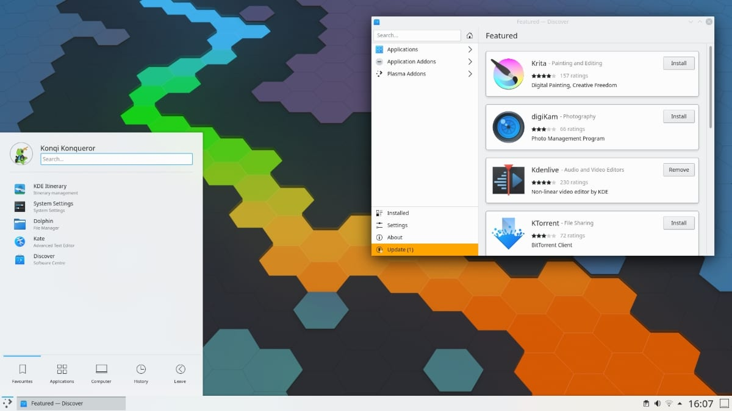
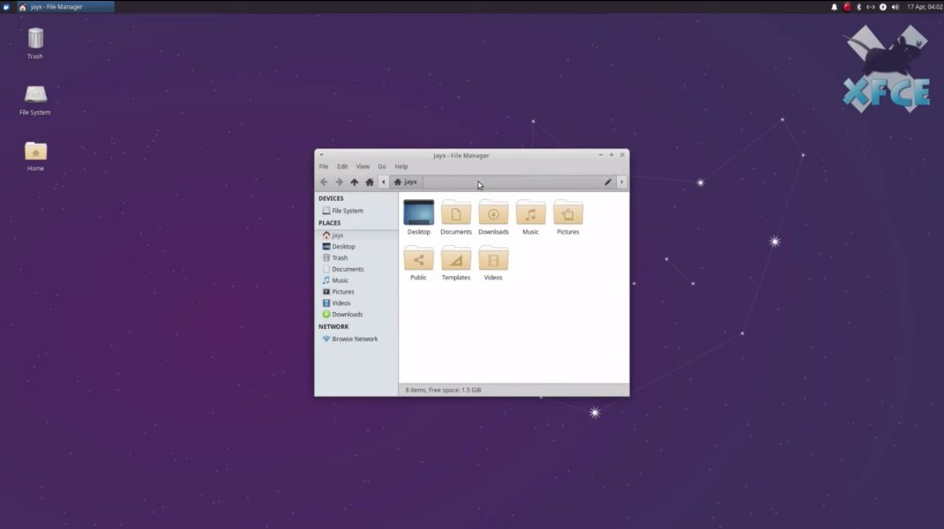
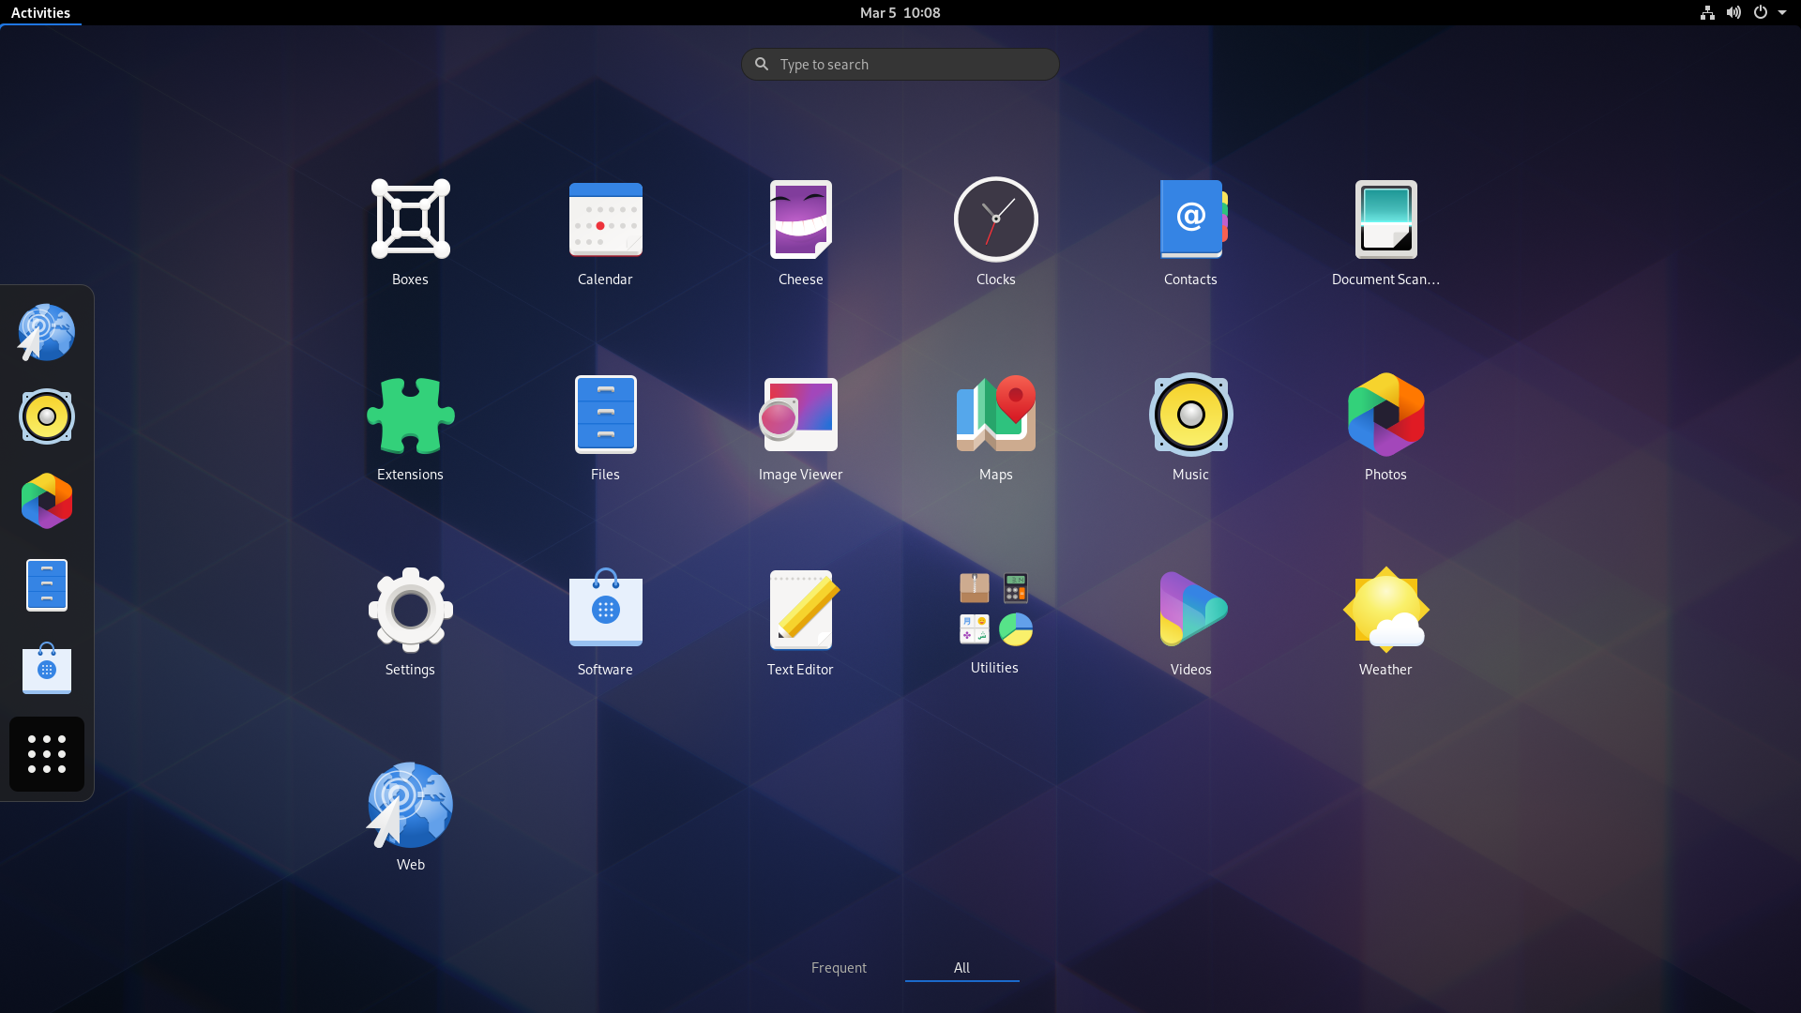
1.4 ICT Skills and Working in Linux
Desktop Skills / Getting to the CLI
GUI vs. CLI
Desktop Environments like Gnome, KDE Plasma, XFCE
Terminals (the CLI)
Presentations
Impress
Beamer
Reveal.js
Projects
Gantt Project
ProjectLibre
KDE
GNOME
XFCE
Notes:
Desktop Environments:
KDE
GNOME
Cinnamon
MATE
Xfce
Deepin
Budgie
Demo: Show GUI DE login options
sudo apt install kde-standard #installs KDE standard on Ubuntu/Debian distros
echo $XDG_CURRENT_DESKTOP #pulls the environment variable
ls /usr/bin/*-session #finds the DE session
neofetch #runs a custom utility
In the GUI, go to Settings > About > look for the DE
Demo: Show terminals
Find the terminal app
Ctrl + Alt +F# #where F# is a function key 1-7, and tty# is the terminal number (ex: F3 = tty3)
Demo: Libre Office Writer, Impress, Sheets

Slide 7
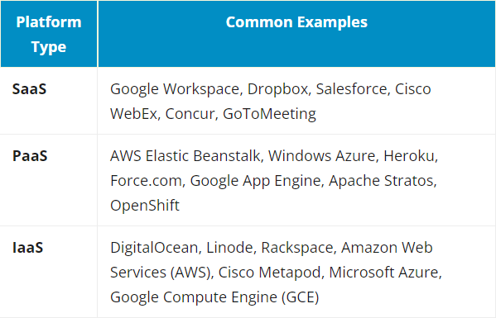
1.4 ICT Skills and Working in Linux
Industry uses of Linux, cloud computing and virtualization
78% of websites are powered by ’Nix [7]
Linux known for stability, flexibility, and performance
Lower cost, greater scalability
Linux prevalent in the cloud as IaaS, PaaS, and SaaS
Linux virtualization/hypervisors include Zen, KVM, and VirtualBox
Common examples of SaaS, PaaS, & IaaS [8]
[7] W3Techs, “Usage Statistics And Market Share Of Operating Systems For Websites, December 2021,” Web Technology Surveys, 18-Dec-2021. [Online]. Available: https://w3techs.com/technologies/overview/operating_system. [Accessed: 18-Dec-2021]
[8] S. Watts and M. Raza, “SaaS Vs PaaS Vs IaaS: What’s The Difference & How To Choose,” BMC Blogs, 15-Jun-2019. [Online]. Available: https://www.bmc.com/blogs/saas-vs-paas-vs-iaas-whats-the-difference-and-how-to-choose/. [Accessed: 18-Dec-2021]
Notes:
Infrastructure as a service (IaaS): operating systems running as guests on a host machine over an important piece of software that is called a hypervisor
Platform as a Service (PaaS): Heroku where program code can just be run without taking care of the underlying containers and virtual machines
Software as a Service (SaaS): Dropbox and Salesforce are two good examples of SaaS (mostly accessed through a web browser)
OpenStack is a collection of open-source software that can make use of different hypervisors and other tools in order to offer a complete IaaS cloud environment on premise

Slide 8
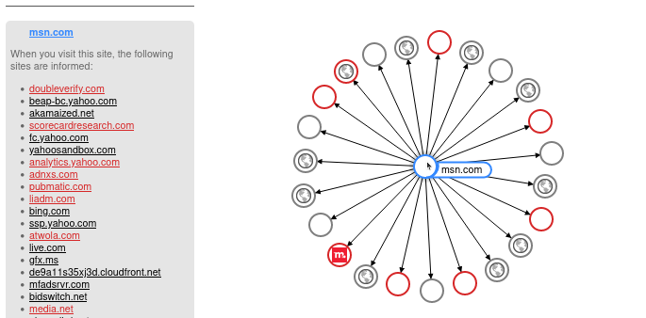
1.4 ICT Skills and Working in Linux
Privacy Issues Using the Internet
Practice safe behaviors
Browser activity is tracked and analyzed by various parties
Don’t allow third party websites to store cookies on your browser
Private/incognito browsing and DNT do not eliminate tracking and are not completely anonymous
Public kiosks, your ISP, leaky DNS
Visualizing Tracking on the Web [9]
[9] Disconnect, Inc., “Disconnect,” Disconnect, Inc., 2021. [Online]. Available: https://disconnect.me/. [Accessed: 18-Dec-2021]

Slide 9
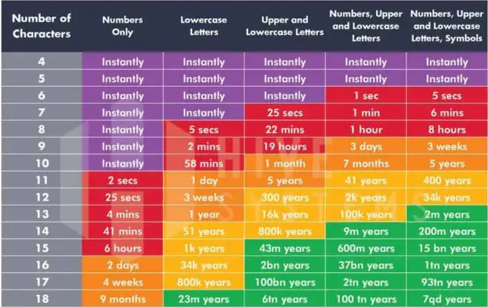
1.4 ICT Skills and Working in Linux
Passwords
You must choose. But choose wisely…
Length + complexity
NO reuse
Use a good password manager and leverage password generator
Time it Takes a Hacker to Brute Force Your Password [10]
Hive Systems, “Are Your Passwords In The Green?,” Hive Systems, 19-Aug-2020. [Online]. Available: https://www.hivesystems.io/blog/are-your-passwords-in-the-green?utm_source=header. [Accessed: 18-Dec-2021]
Notes:
Commands:
passwd -h
man passwd
sudo passwd susan #not asked for old passwd
sudo passwd -s susan
sudo passwd -Sa #check status for all accounts
sudo passwd -Sa |grep -e 'linuxgeek\|susan’ #check status for specific accounts
sudo passwd -e susan #force users to change password at next login
passwd -e susan

Slide 10
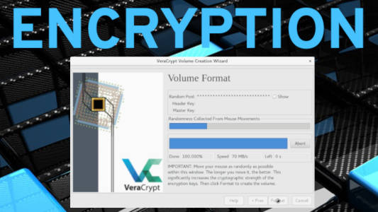
1.4 ICT Skills and Working in Linux
Encryption
Data at rest/transit should be protected
Transport Layer Security (TLS) offers confidentiality for network connections
TLS uses symmetric and PKE
To determine if a website is trustworthy, look for the lock icon in the url bar, inspect the certificate, and use HTTP over TLS (HTTPS) sites
GNU Privacy Guard used to encrypt and digitally sign emails
FDE using dm-crypt or the Linux Unified Key Setup (LUKS)
Veracrypt for creating file vaults
Hive Systems, “Are Your Passwords In The Green?,” Hive Systems, 19-Aug-2020. [Online]. Available: https://www.hivesystems.io/blog/are-your-passwords-in-the-green?utm_source=header. [Accessed: 18-Dec-2021]
Notes:
Commands:
sudo apt install cryptsetup #install cryptsetup if not installed
sudo lshw -short -C disk #show available drives
sudo cryptsetup --verbose luksFormat /dev/ #encrypt your drive
sudo cryptsetup luksDump /dev/sdc #view encryption metadata
sudo cryptsetup --verbose luksOpen /dev/sdc data #decrypt LUKS drive to data folder

Slide 11


Join at https://app.sli.do/event/4Fe6cFY4joADVit8QUo9QY

Slide 12

Demos
Based on Red Hat Enterprise Linux (RHEL)
Oracle Linux is an open-source clone
Did You Know? Oracle’s Linux distro is a clone of RHEL and used in the Oracle Cloud Infrastructure (OCI).

Slide 13

Notes:
Interested?
• Contact the email address or connect via social media links at the bottom of the graphic
• Mention that you were referred by Dr. Galliano.

Slide 14
What Questions Do you Have?

